Slide 1
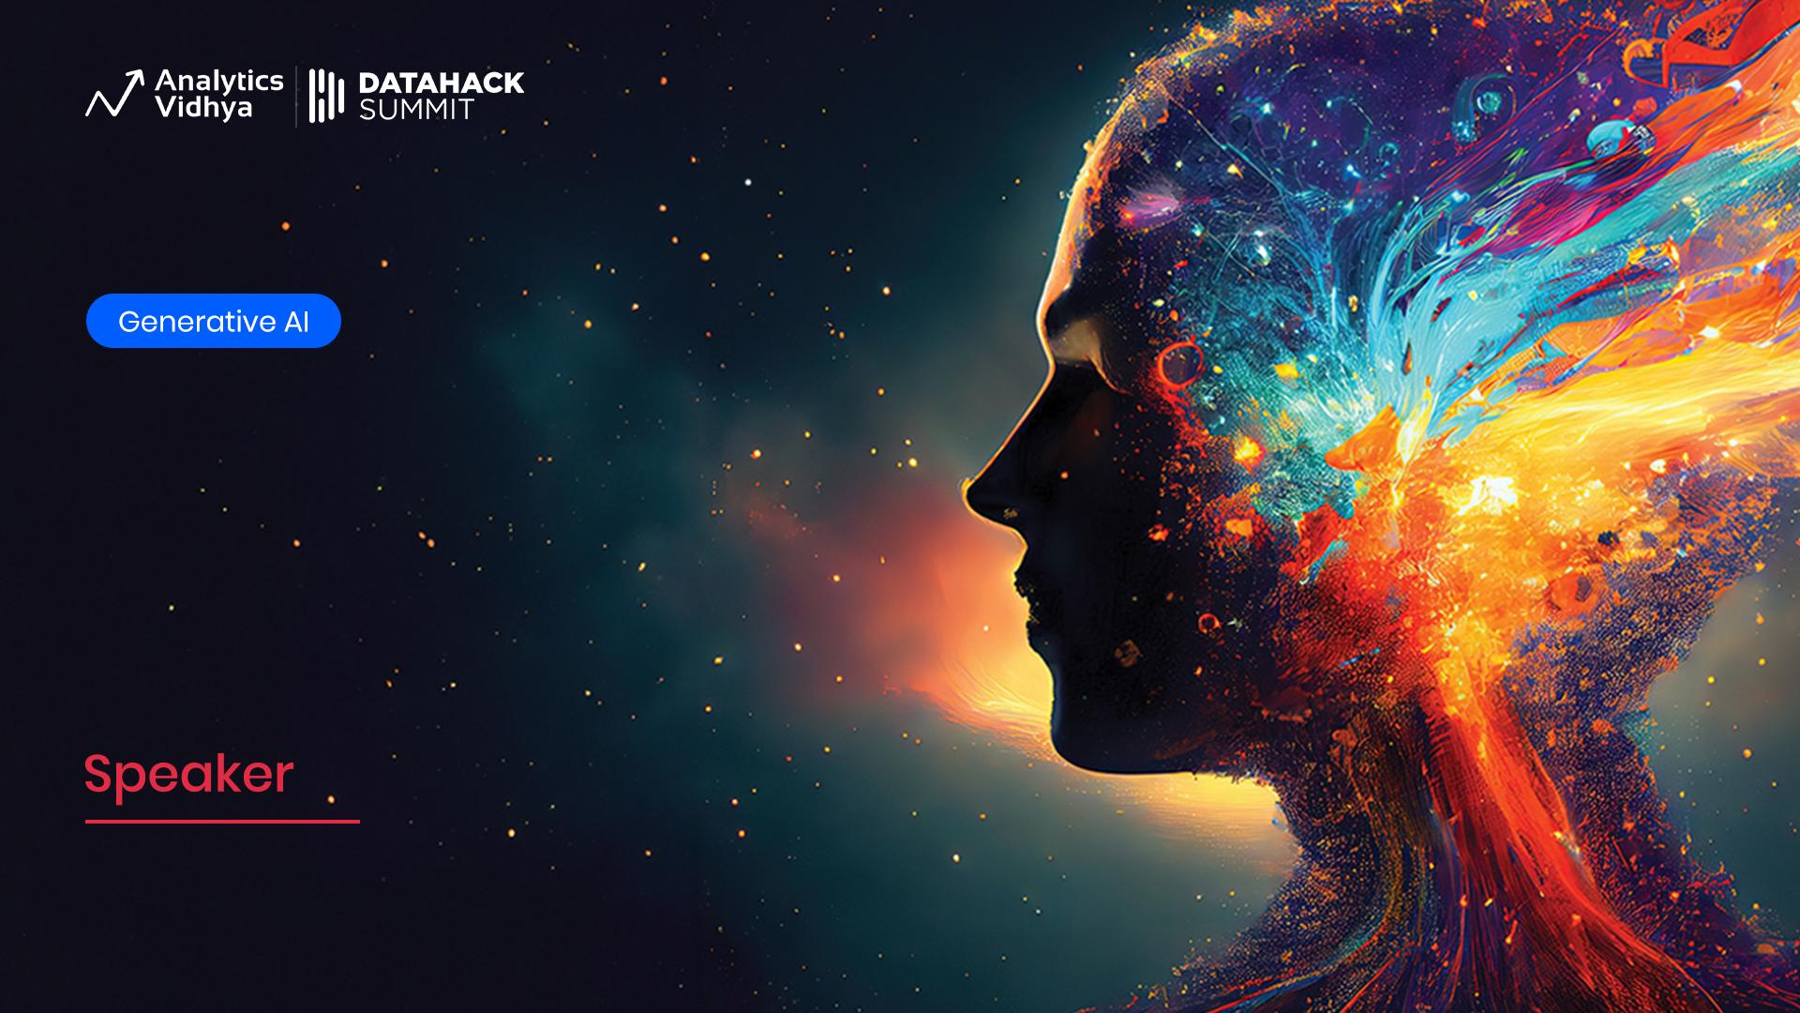
Building Your Own Search Engine Using Vector Databases
Deepanshu Lulla
Senior Software Engineer Technical Lead, Analytics and Insights

Slide 2

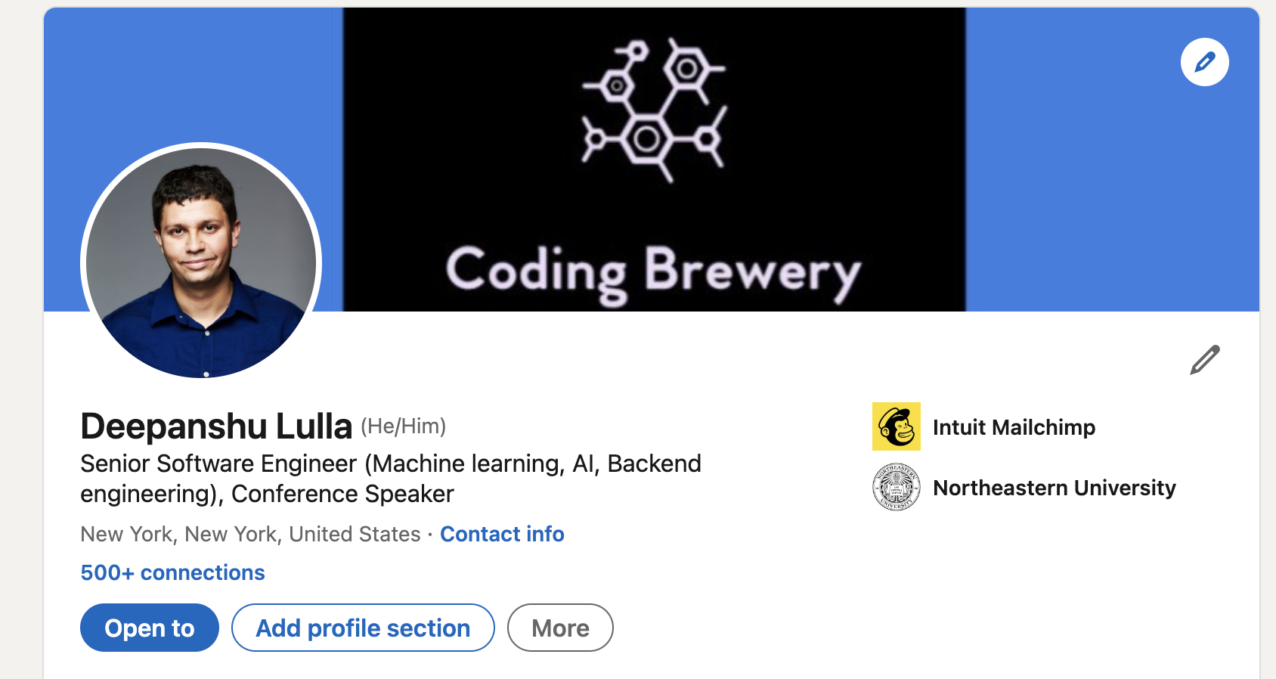
About Me

Slide 3
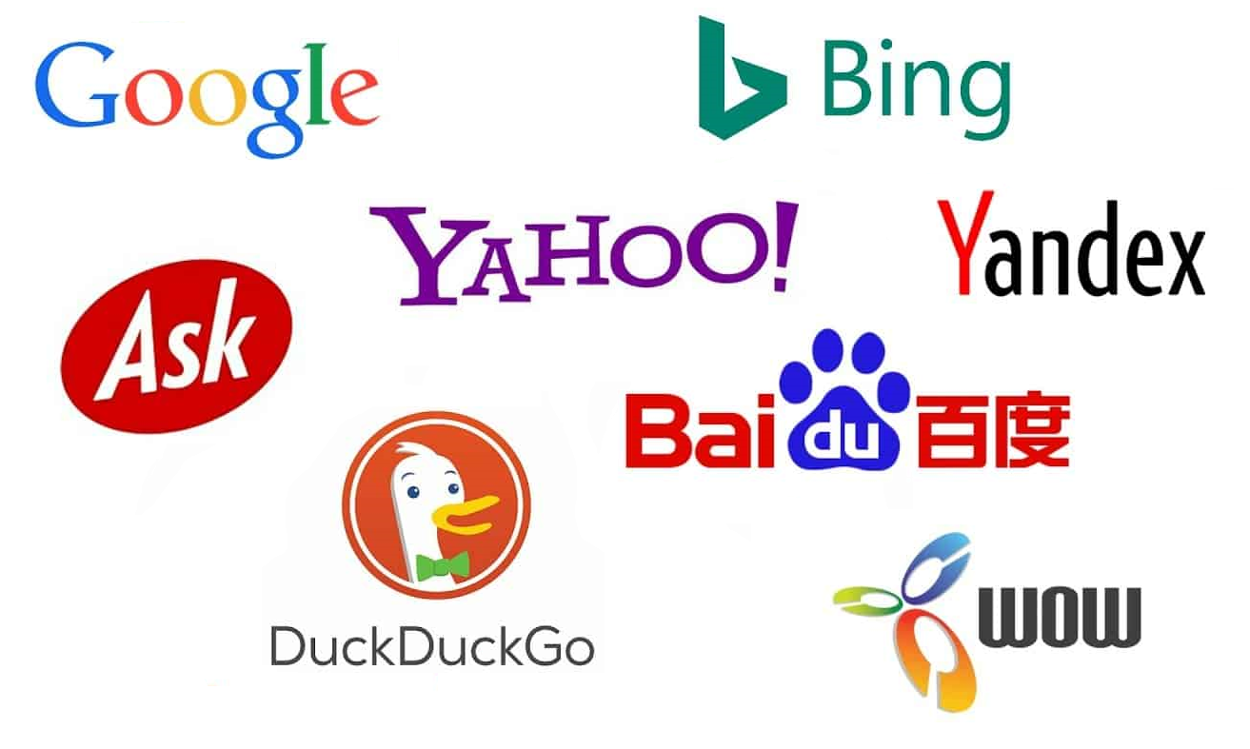
Welcome and Objectives
Ice Breaker:
How are you all using AI or Generative AI in your organization?
Objectives:
Understand the core concepts behind Vector Databases and Semantic Search
Discuss how these tools are transforming the landscape of Search Engines
Explore real-world applications and use-cases
Engage in hands-on exploration, implementing the concepts discussed
Prerequisites:
Basics of NLP
Python
Langchain (helpful but not required)
Notes:
Slide 1: Welcome and Objectives
Welcome attendees
Outline the objectives of the presentation
Ice breaker activity to engage attendees
Set the stage for exploration

Slide 4



Context setting
Current Landscape
Potential Use-Cases, Benefits, and Challenges
Highlight the significance of building an AI search engine with your data
Keyword Search
Semantic Search
Notes:
Context Setting
Brief overview of AI
Introduction to Search Engines
Discuss the current landscape
Discuss potential use-cases, benefits, and challenges
Highlight the significance of building an AI search engine with your data

Slide 5
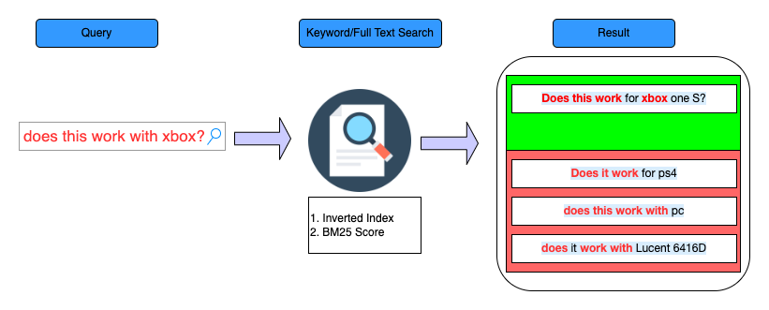
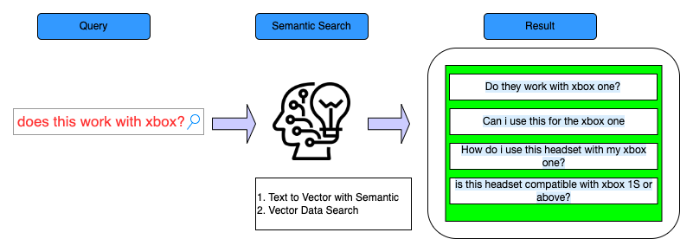
Context setting
Introduction to Search Engines
Types of Search
Keyword Search
Semantic Search
Keyword Search
Semantic Search
Notes:
Context Setting
Brief overview of AI
Introduction to Search Engines
Discuss the current landscape
Discuss potential use-cases, benefits, and challenges
Highlight the significance of building an AI search engine with your data

Slide 6
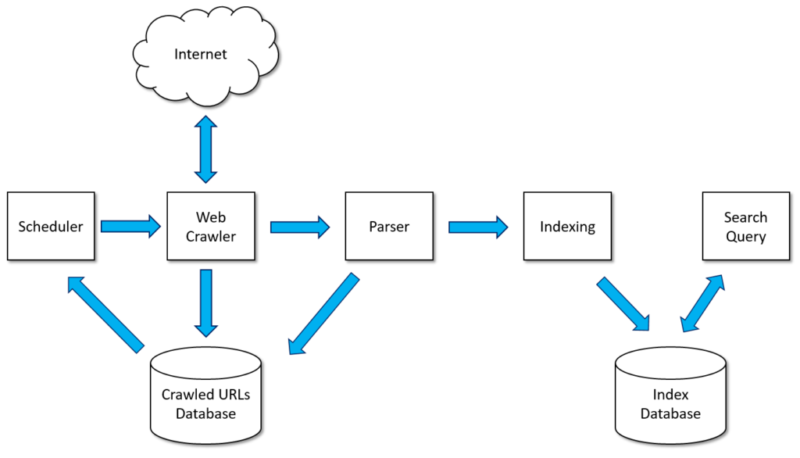
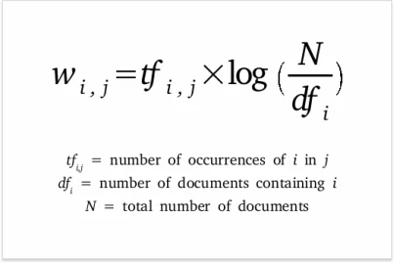
How Search Engines work?
How Search Engines work (Keyword Search)
Keyword Search
Scoring plays an important part in determining relevance during a search operation.
Algorithms For Keyword search and default similarity algorithm
TF-IDF
Practical Search Algorithm( Elastic search’s default algorithm)
Notes:
Explain what NLP is
Discuss the role of NLP in Search Engines
Discuss Machine Learning algorithms used in crafting efficient AI search engines

Slide 7
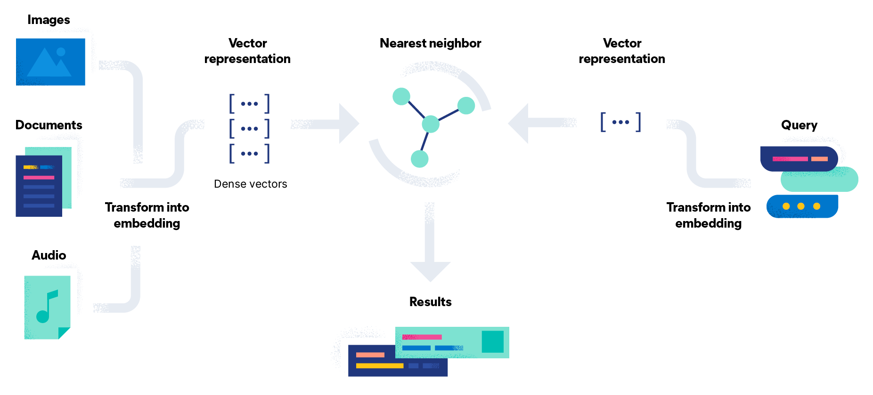
How Search Engines work?
How Semantic Search Engines work
Pillars of Semantic Search
NLP and Text Data Vectorization
Vector Search
Algorithms Behind Generating Vector Embeddings | Algorithms Behind Generating Vector Search
Bag of Words(BoW) | k-Nearest Neighbors (k-NN)
Word2vec | Hierarchical Navigable Small World (HNSW)
BERT | Product Quantization
Notes:
Explain what NLP is
Discuss the role of NLP in Search Engines
Discuss Machine Learning algorithms used in crafting efficient AI search engines

Slide 8
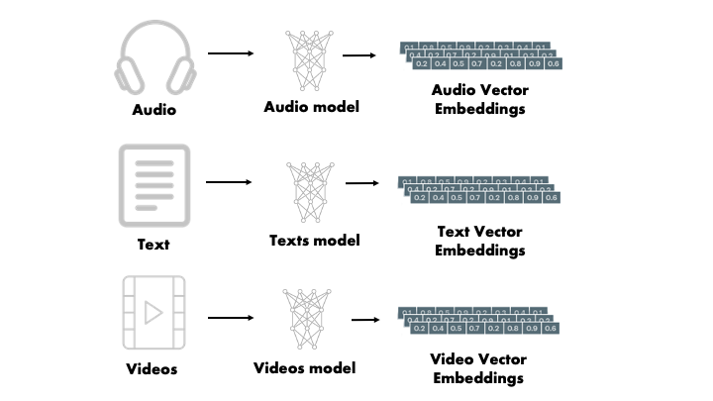
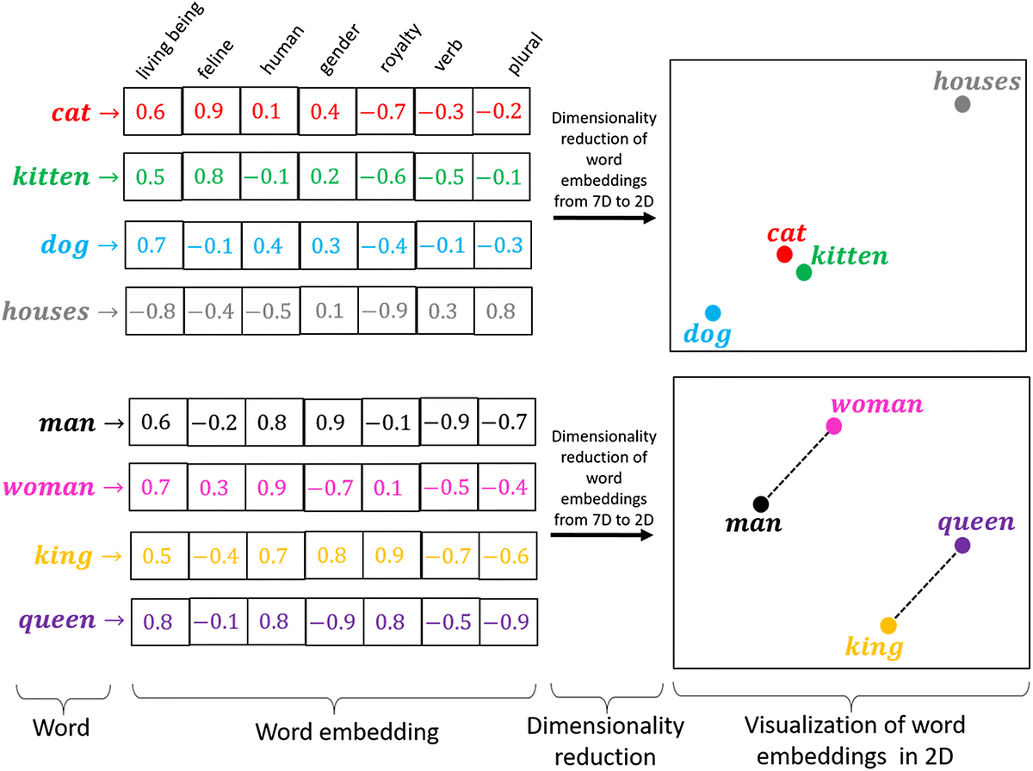
Vector Embeddings
Used to convert data into an easy format for computers to understand. Those formats are Vector Embeddings
Popular Word Embeddings
Count Vector
TF-IDF Vector
Continuous Bag of words(CBOW)
Skip-Gram
word2Vec
Global Vectors for Word Representation(GloVe)
Bidirectional Encoder Representations from Transformers(BERT)
Notes:
What are vector embeddings?
Explanation of legacy vectorizing techniques like CountVectorizer, Bag of Words

Slide 9
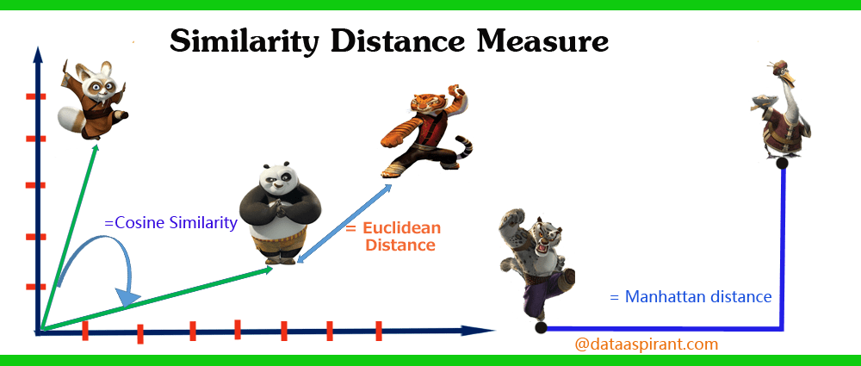
Similarity Measures
Similarity measures allow you to quantify semantic relationships between two entities
Cosine Similarity: Popular for Dense vectors like NLP usecases. Measures angles between them
Euclidean distance
Manhattan Distance
Notes:
Slide 5: Similarity Measures
Explanation of similarity measures and how they work

Slide 10

LLM and Transformers
Word 2 vector Limitations
does not consider the order of words.
generates a single vector representation for each word, regardless of the context.
Transformers
Solve this Problem by understanding the contextual meaning of words by
creating vector embeddings that are more context-aware.
2) Introduced by Paper “Attention is All you need.” based on self-attention, the model can weigh and understand each word’s impact on others in a sentence.
2) Transformer Model Architectures
BERT
GPT
Notes:
LLM and Transformers
Discuss Language Models and Transformers
Explain their importance and role in semantic search
To overcome these limitations, researchers developed new techniques and models that could understand context better.
**Contextual Word Embeddings (ELMo, etc.)**: ELMo (Embeddings from Language Models) assigns embeddings to words based on their context, addressing the polysemy issue present in Word2Vec.
**Transformers**: The Transformer model, introduced in the paper "Attention is All You Need," revolutionized NLP. It's based on the idea of self-attention, allowing the model to weigh and understand the impact of each word on others in a sentence.
The transformer model architecture underlies models like BERT (Bidirectional Encoder Representations from Transformers) and GPT (Generative Pretrained Transformer). Unlike Word2Vec, these models provide context-aware representations by considering words in their specific context.
**BERT** uses bidirectional training of Transformers, meaning it looks at the context from both left and right sides (words before and after the target word).
**GPT** uses a transformer decoder and is trained in a unidirectional manner. It has been used extensively for tasks that require the generation of text.
In summary, while we started with Word2Vec creating context-free embeddings, we've moved toward Transformer-based models that provide powerful context-dependent representations, leading to significant improvements in various NLP tasks.

Slide 11
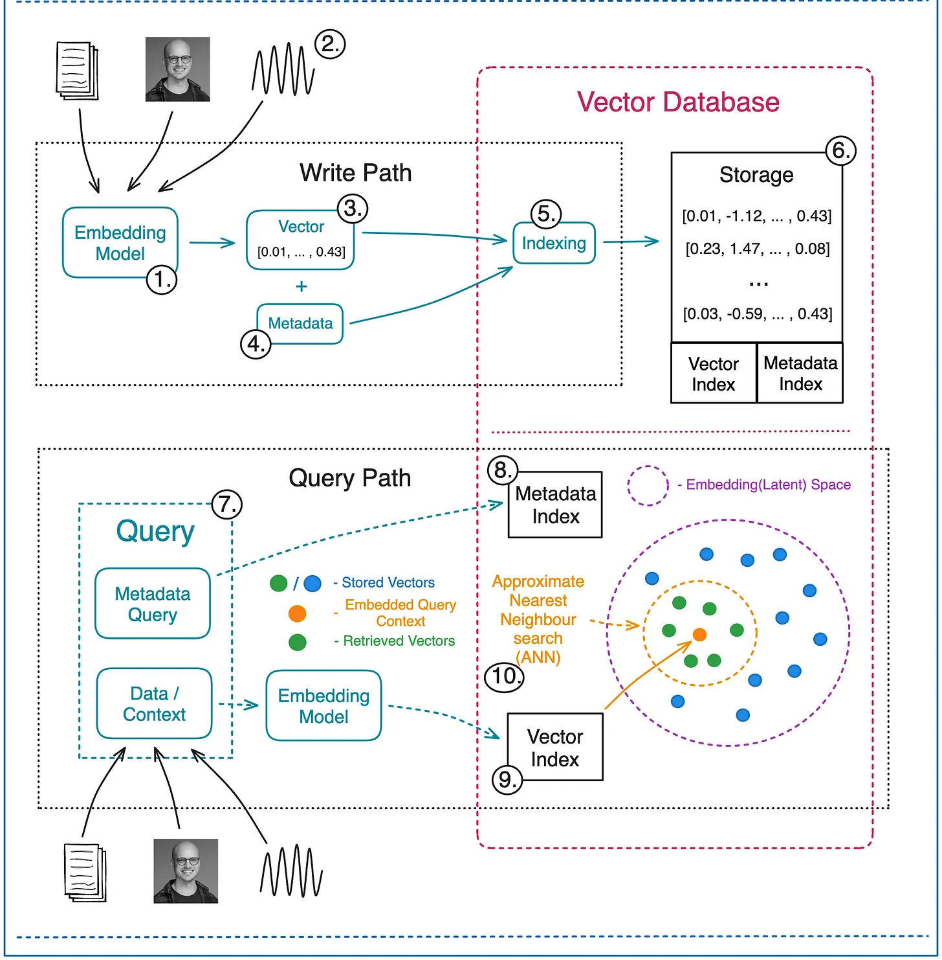
Vector Databases
Designed to enable fast and efficient similarity search in high-dimensional vector spaces.
Serve as a bridge between the offline training of models and the online results serving.
Provide a scalable solution for storing and retrieving large amounts of high-dimensional vector data.
Notes:
Vector Databases
Explanation of vector databases
Discuss how they work

Slide 12
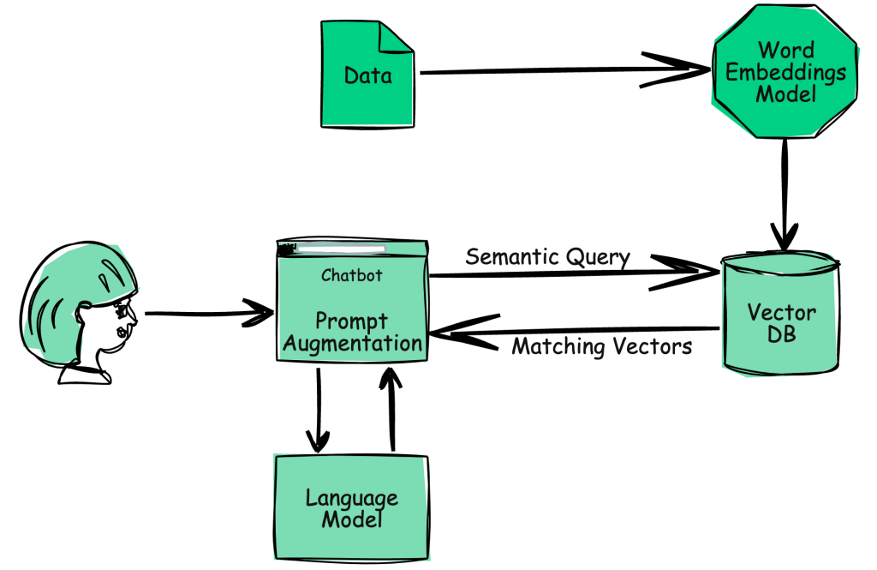
Retrieval Augmented Generation
It combines the best of retrieval-based and generative methods in NLP to answer questions or search queries.
It has 3 parts
Query Understanding
Document Retrieval
Answer Generation
Notes:
Here's a simplified explanation of how this might work:
1. **Query Understanding:** Similar to traditional natural language search, the first step in RAG is understanding the user's query, which can involve Named Entity Recognition (NER), Part-of-Speech tagging (POS tagging), and other techniques to parse and interpret the query.
2. **Document Retrieval:** RAG first retrieves a subset of documents from a larger corpus that are most relevant to the user's query. This retrieval step is based on a similarity measure, such as cosine similarity in the case of vectorized representations of text. The result is a shortlist of documents that are likely to contain the answer to the user's query.
3. **Answer Generation:** Once the relevant documents are retrieved, a separate generative model takes the user's query and the retrieved documents as input and generates a response. The generative model can be a sequence-to-sequence model like a Transformer, which is trained to generate coherent and contextually appropriate text.

Slide 13

Steps To RAG
Document Loading and Splitting
Generating Vector Embeddings
Retrieval
LangChain is a framework for developing applications powered by language models.
It enables applications that are:
Data-aware: connect a language model to other sources of data
Agentic: allow a language model to interact with its environment
Notes:
Real-world use-cases
Share examples of real-world use-cases of vector databases

Slide 14
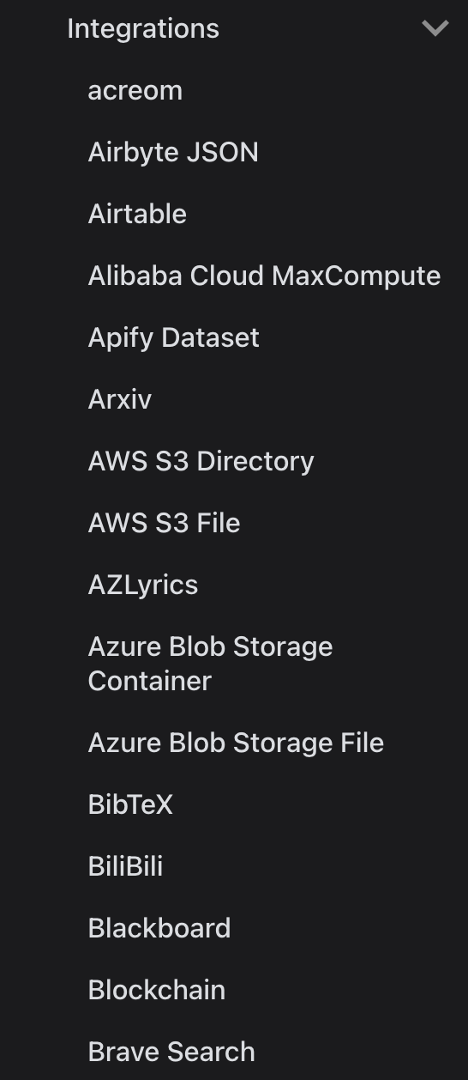
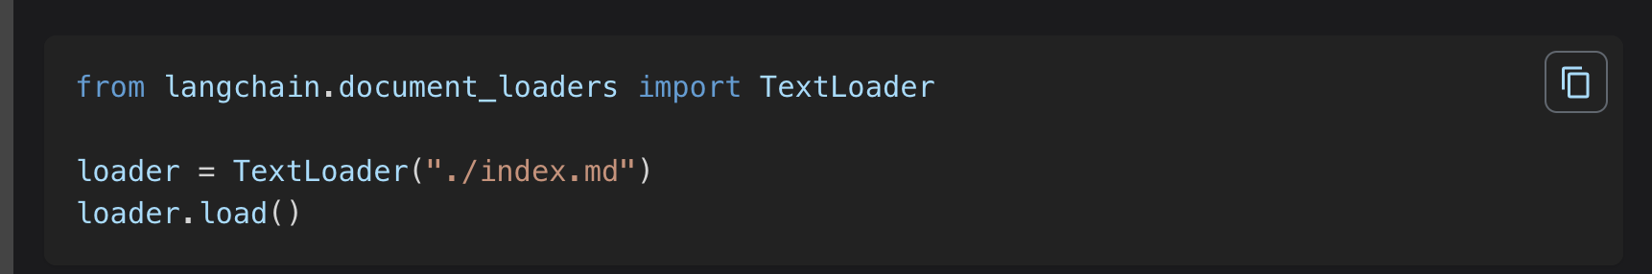
Loading the Data
Use document loaders to load data from a source as Document’.
A wide range of integrations are available to load data.
Notes:
Slide 10: Splitting the Data
Explain why data splitting is required
Discuss different kinds of data splitting

Slide 15
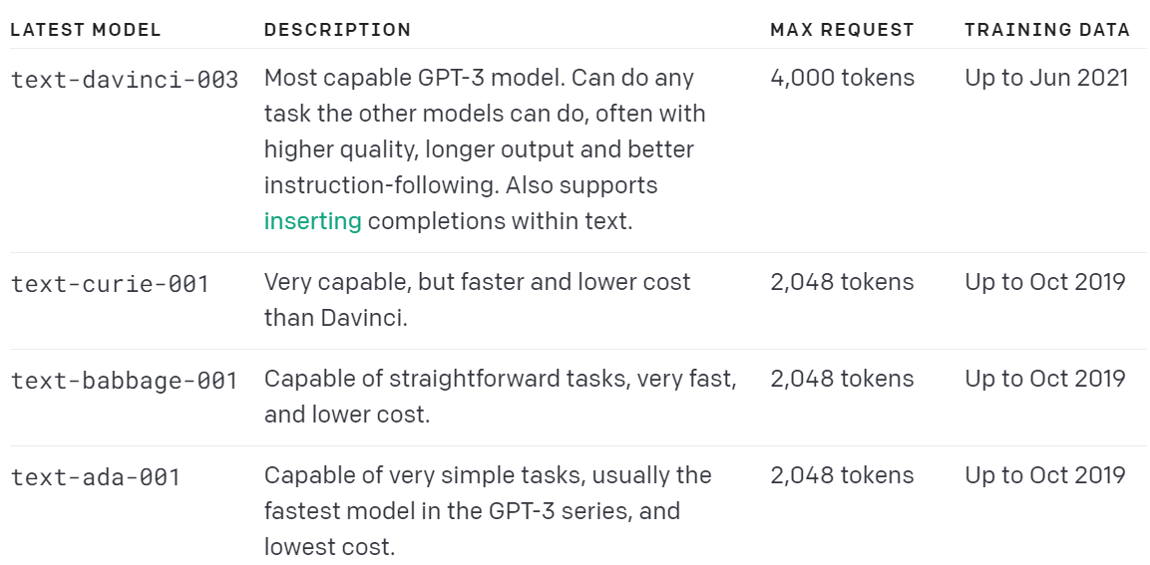
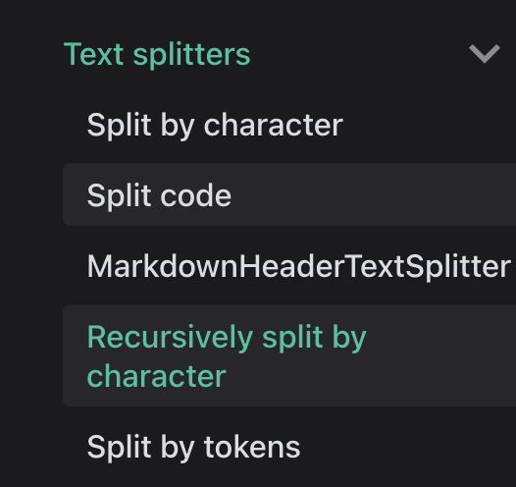
Splitting the Data
Reason For Splitting Data
Helpful when dealing with large amounts of data.
Chatgpt and LLM have limits.
Allow for a more efficient search.
Available Text splitter in Langchain
Notes:
Slide 10: Splitting the Data
Explain why data splitting is required
Discuss different kinds of data splitting

Slide 16
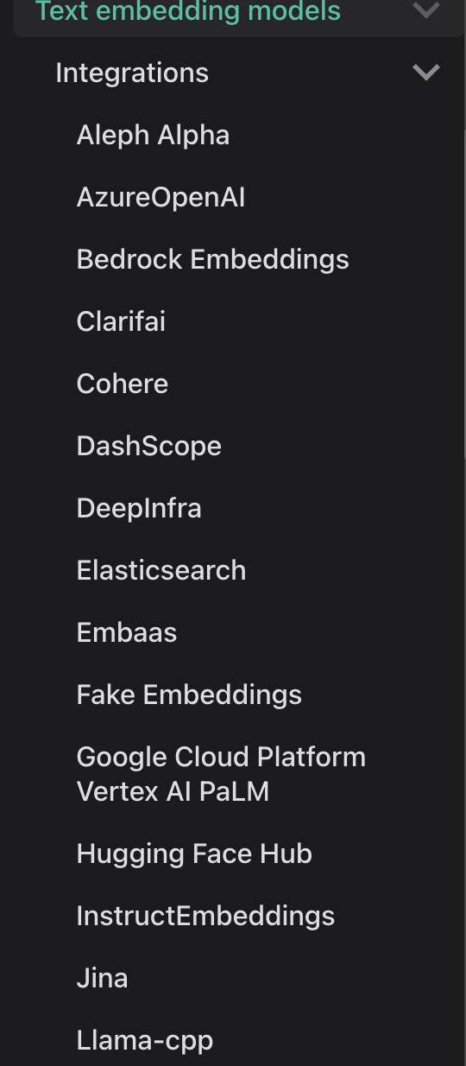
Embeddings
Embeddings create text vectors for semantic search.
Support for Different Embedding Models.
Notes:
Slide 12: Semantic Search
Discuss the integration of NLP and Machine Learning in semantic search
Code demonstration (if possible)

Slide 17
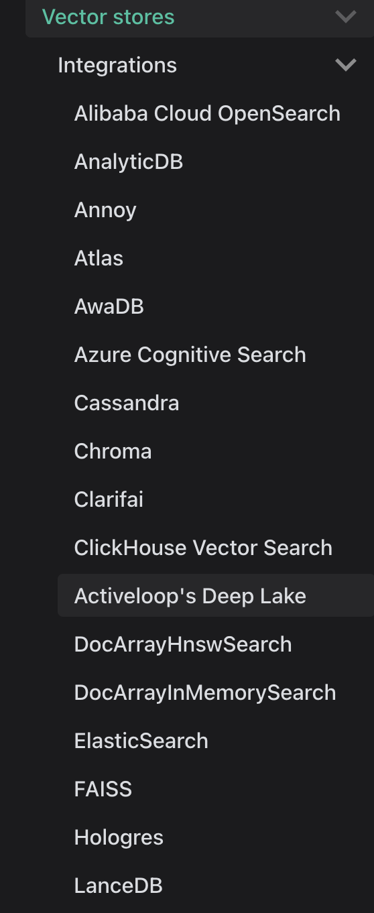
Vector Databases
Embeddings create text vectors for semantic search.
Support for Different Embedding Models.
Notes:
Slide 12: Semantic Search
Discuss the integration of NLP and Machine Learning in semantic search
Code demonstration (if possible)

Slide 18
Retrieval Algorithms
Depending upon the choice of your vector store, you can have multiple options supported as an option for data retrieval.
For Chroma DB
Similarity Search
Leverages distance metrics in the vector space to find similar items.
A key component of vector databases and semantic search.
Examples of metrics include cosine similarity, Euclidean distance, etc
Maximal Marginal Relevance (MMR)
Emphasizes relevance and diversity in retrieval.
Reduces redundancy in results by re-ranking.
Useful when you have duplication in your documents.
Notes:
Slide: Retrieval Algorithms
Discuss different retrieval algorithms like MMR, LLM Aided Retrieval, and Compression

Slide 19

!

